Slide 1



Hardware and Software Fundamentals of Intelligent Computing Systems

Slide 2
Lecture 26: Multi-Chip Backend Support II (Runtime Integration)

Slide 3

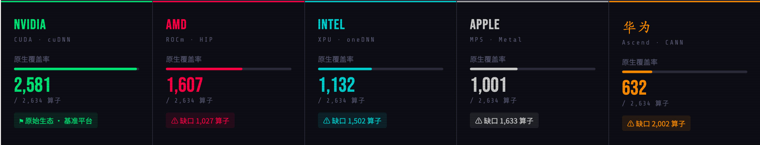
Runtime Multi-Backend Support Layer
Necessity
Taking PyTorch as an example, the native framework contains over 2600 low-level operators .
For hardware vendors to integrate, the traditional approach requires writing C++ backend implementations one by one and modifying the framework's core code.
The ecosystem is severely fragmented, and the cost of compute migration is extremely high.
FlagTree/FlagGems Solution Approach
Decouple compile-time and runtime through a unified Runtime .
https://github.com/flagos-ai/KernelGen/blob/main/AtenOperator.md, visualized by Claucd Sonnet 4.6 Extended.

Slide 4
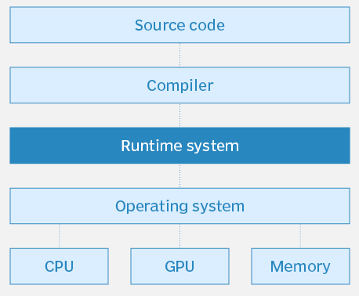
Runtime System Responsibility Boundaries
Device Management: Initialization and state maintenance of hardware contexts.
Memory Scheduling: Managing the allocation and deallocation of device memory.
Data Transfer: Host-to-Device (H2D) and Device-to-Host (D2H) data movement.
Instruction Dispatch:
Distributing compiled kernel binaries to the correct physical devices and synchronizing execution streams.
Providing a highly abstracted layer of API Wrapping, shielding the vast differences in low-level driver API s across different hardware vendors.
https://www.techtarget.com/searchsoftwarequality/definition/runtime

Slide 5
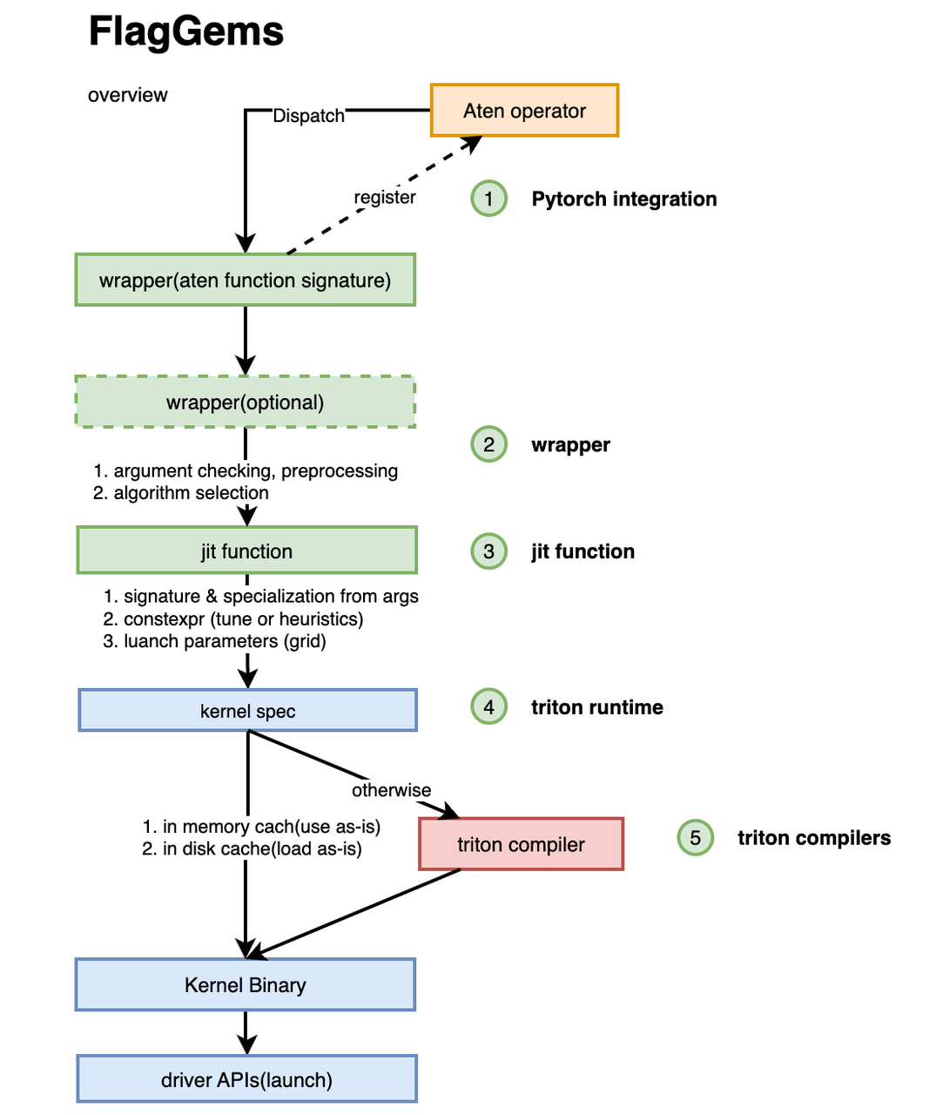
API Wrapping Paradigm
Case Study: FlagGems's ATen Transparent Interception
Design Philosophy: Avoid modifying users' existing model code; expose a fully consistent API.
Out-of-Tree Registration Mechanism: FlagGems leverages torch.Library and other low-level API for out-of-tree (Out-of-tree) extension .
Interception Workflow: Intercept native ATen operator calls -> Provide backend-specific Triton implementation -> Forcibly override native behavior .
Enable seamless compute migration for model developers, without modifying any existing code.
https://github.com/pytorch/pytorch/issues/139602

Slide 6
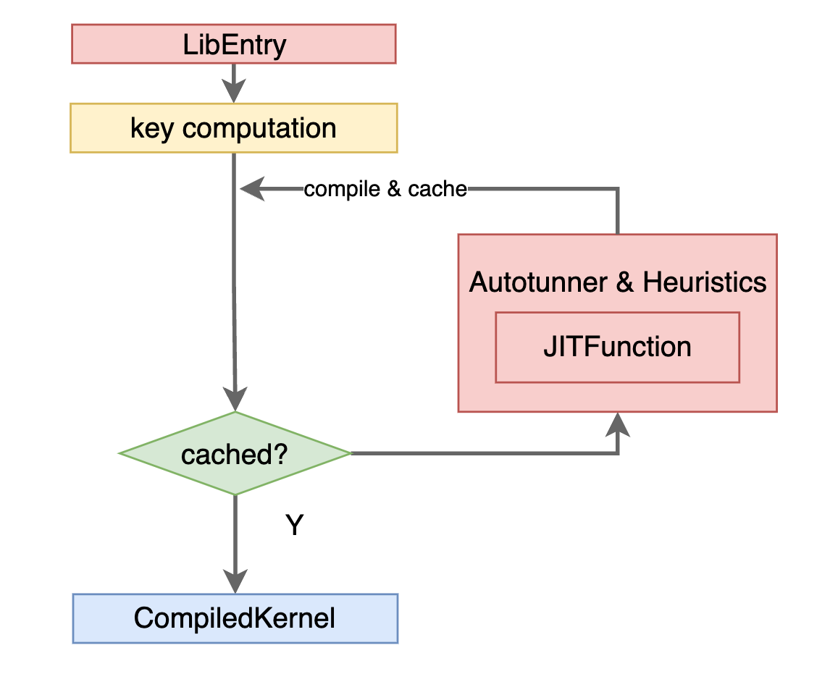
ReducingOverhead:Runtime Optimization
Problem: Frequent Python API calls and Just-In-Time compilation (JIT) introduce significant runtime overhead.
Solution: Introduce LibEntry runtime wrapper.
Advantages: Eliminate Python GIL contention.
Fully offload operator wrapping logic, registration mechanisms, and execution stream management to the C++ layer, deeply integrating CUDA/low-level driver workflows .

Slide 7
Environment Variable-Driven Backend Routing
FlagTree compiler and FlagGems operator library integrate over 10 hardware platforms:
NVIDIA GPU, Kunlunxin (Kunlunxin), Iluvatar (Iluvatar), MetaX (MetaX), Moore Threads (MThreads), Huawei Ascend (Ascend), and Tsingmicro (Tsingmicro) and other.
Lazy Loading Lazy Loading backend support:
The user interface is unified as import flag_gems; flag_gems.enable() .
Auto-detection and Manual Override: The system attempts to automatically detect hardware; if it fails, it relies on environment variables .
Routing Switch: Use export GEMS_VENDOR=<vendor_name> to forcibly specify the dispatch target (e.g., nvidia, tsingmicro).
Ensure strict isolation of multi-branch physical files to reduce code conflicts.
https://github.com/flagos-ai/FlagGems/blob/master/docs/how_to_use_flaggems.md

Slide 8
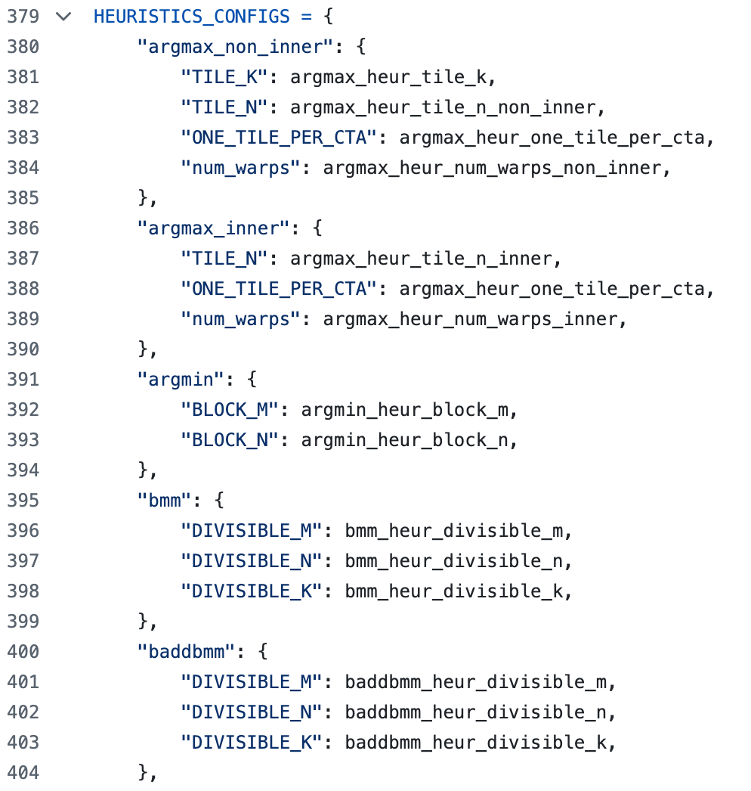
FlagGems Hardware Specialization Priority Dispatch
Generic MLIR lowering code is functionally correct but may not achieve the specific hardware's optimal performance.
Specialization Dispatch Logic: Before dispatch, the system first checks whether vendor-optimized versions exist under backend/<vendor>/ops/ or fused/ .
If a specialized version exists, the generic cross-platform logic is short-circuited (Short-circuit), routing directly to the specialized code.
https://github.com/flagos-ai/FlagGems/blob/master/src/flag_gems/runtime/backend/_tsingmicro/heuristics_config_utils.py

Slide 9
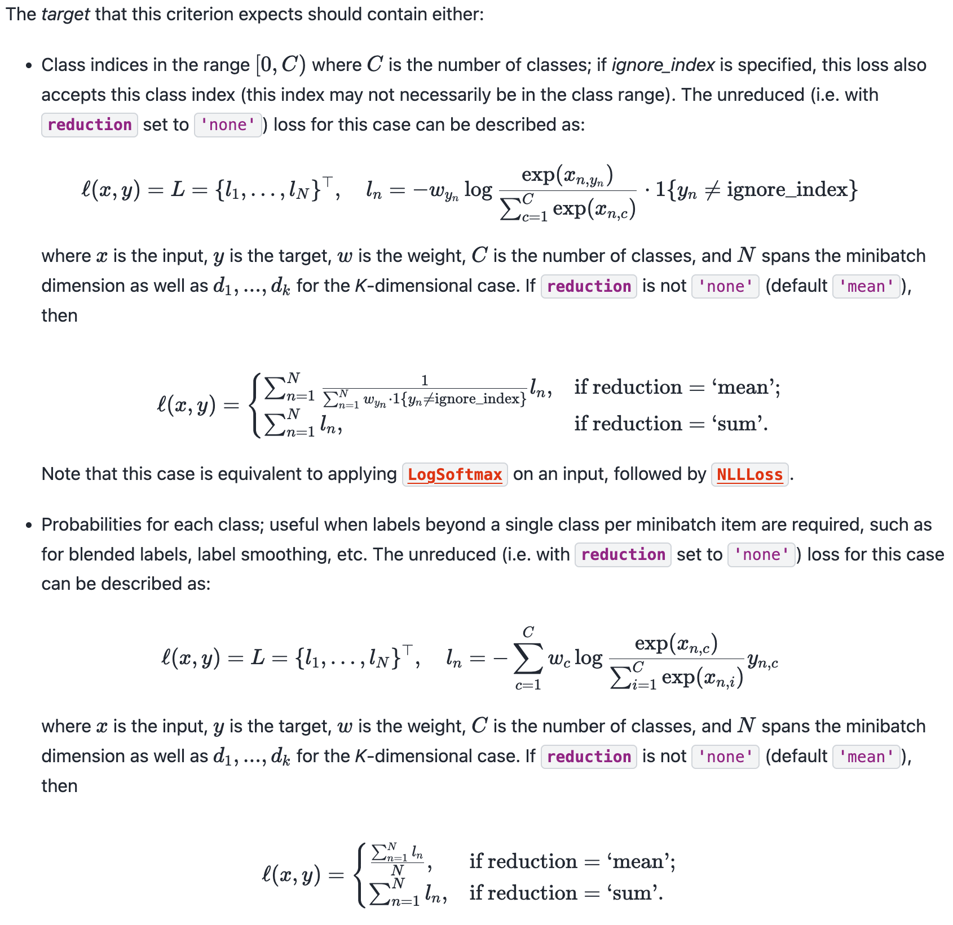
Case Analysis: Tsingmicro
Cross-Entropy is central to LLM training.
Mathematical Expansion:
Hidden state projection to compute Logits -> Softmax normalization extraction -> negative log-likelihood evaluation.
Modern LLM have large vocabulary sizes (32K-128K), making intermediate variable matrices grow significantly.
Default Execution:Replaceintermediate variable matrices back to HBM, and reload them for the next computation..
Memory access becomes a bottleneck,significant waste of compute resources.
https://docs.pytorch.org/docs/stable/generated/torch.nn.CrossEntropyLoss.html

Slide 10
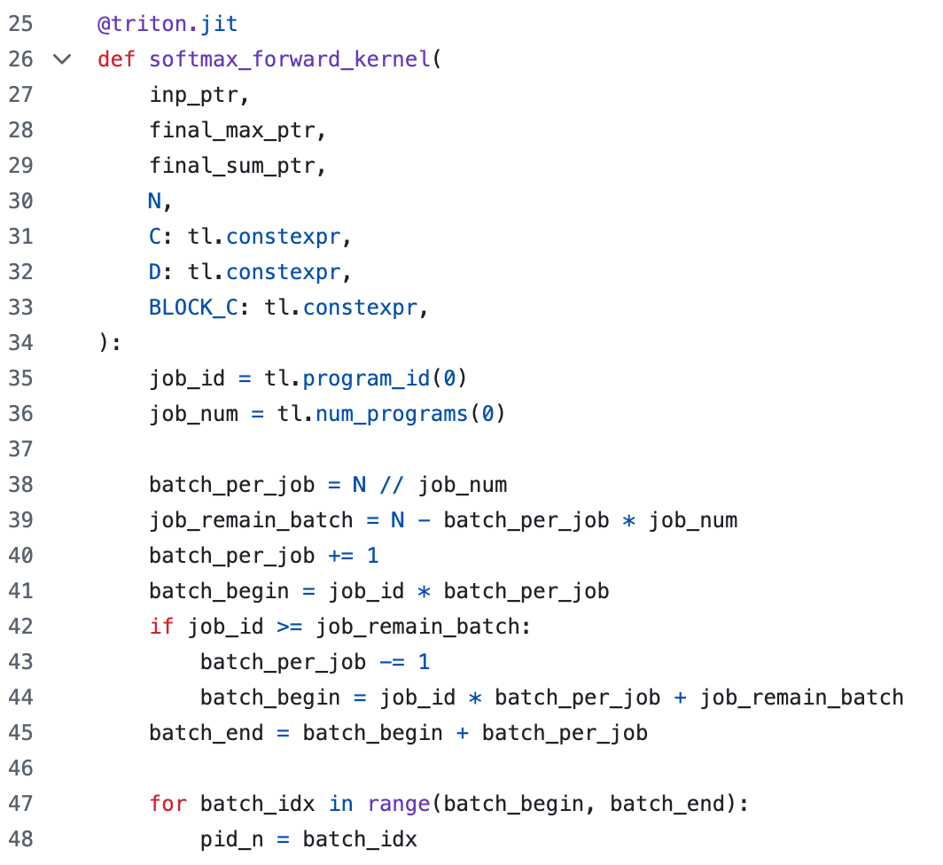
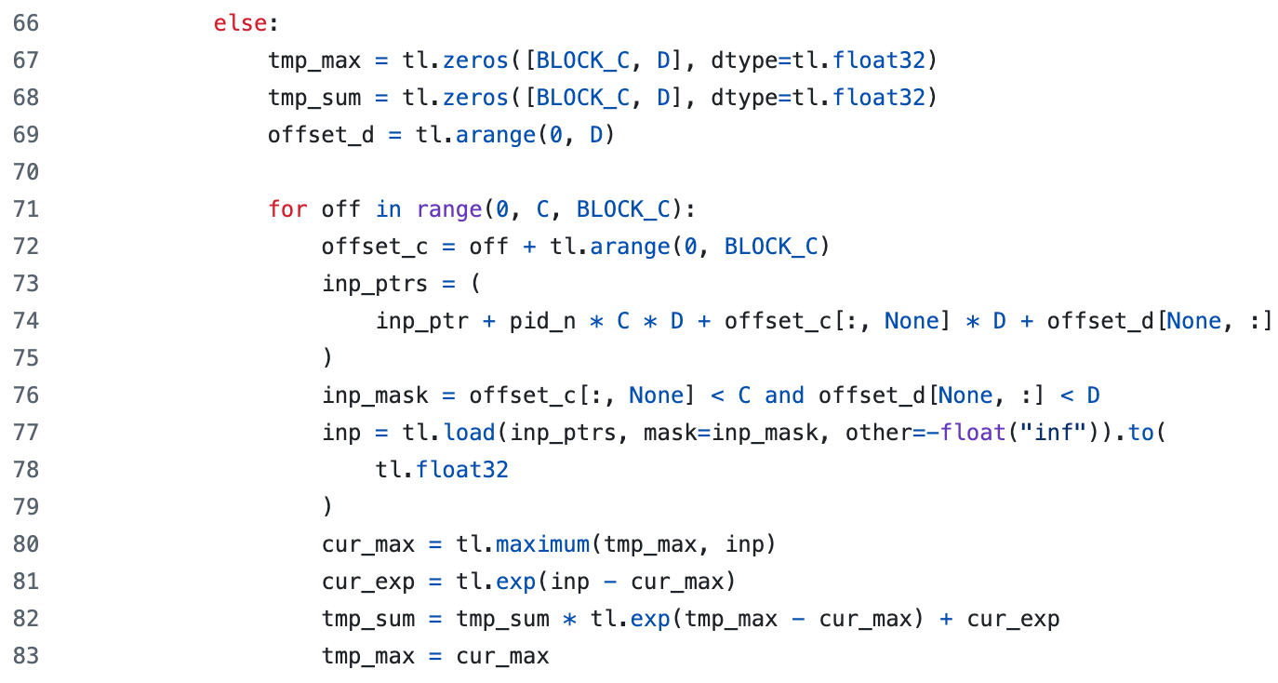
Case Analysis: Tsingmicro
Online Log-Sum-Exp Algorithm
Tsingmicro implements a specialized fused linear cross-entropy Triton kernel.
Avoid materializing intermediate Logits tensor materialization, leverages SRAM to perform efficient Online LSE.
Optimize with Tsingmicro chip-specific shared memory management instructions and warp (Warp) synchronization strategies for optimization.
Code Location: src/flag_gems/runtime/backend/_tsingmicro/fused/cross_entropy_loss.py

Slide 11
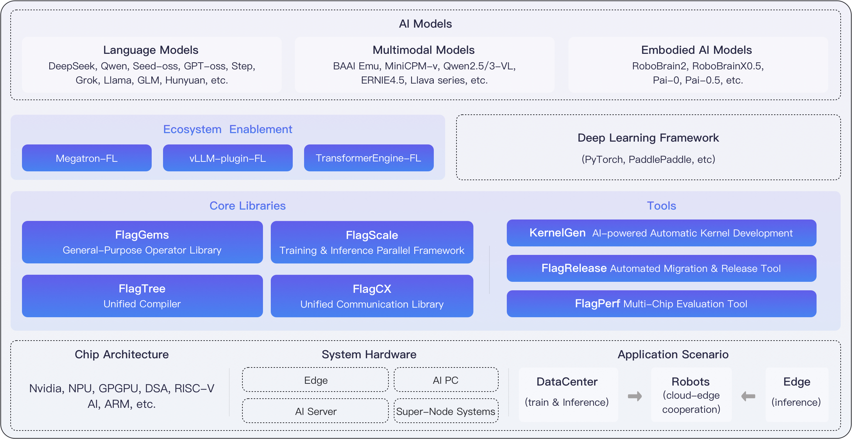
Case Analysis: Tsingmicro
System-Level Significance of Specialization Priority
An advanced Runtime integration mechanism is essentially a router that intelligently balances generality and specialization.
FlagTree is responsible for generic graph lowering and code generation (generalization).
FlagGems 's Backend folder provides a Short-circuit (specialization).
https://docs.flagos.io/en/latest/overview.html

Slide 12
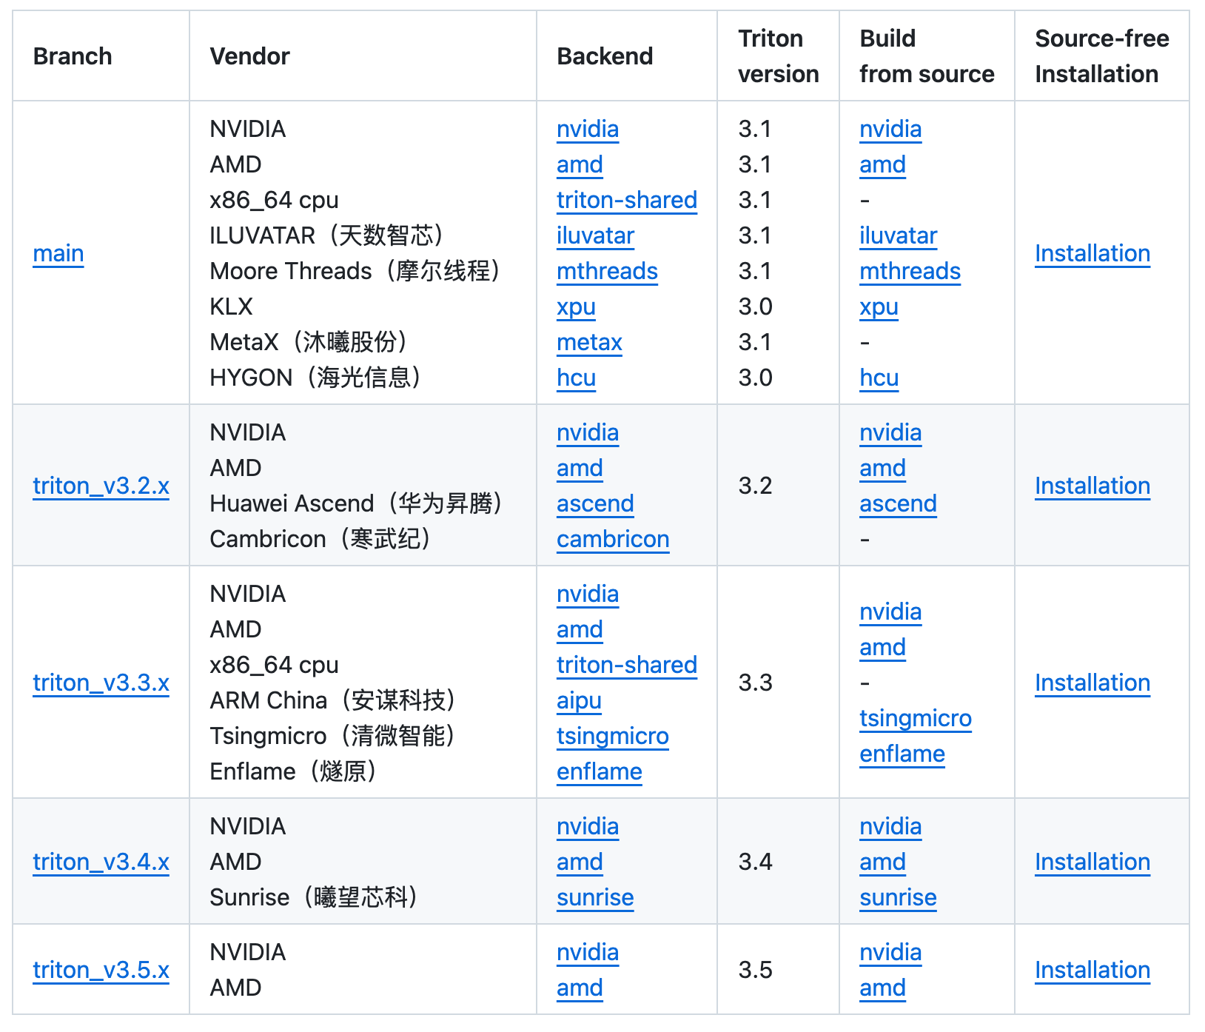
Lab: Adding a New Hardware Backend to FlagTree
Lab Description: New Chip NeuroX Integration Plan
Lab Objective: Learn how to use FlagGems plugin mechanism to add Runtime backend support for a fictional new AI chip NeuroX and add Runtime backend support.
Applicable Scenario: Simulate the real engineering process of a chip vendor integrating into a unified large model infrastructure.
Core Requirements: Follow unified API wrapping and enable independent maintenance.
https://github.com/flagos-ai/FlagTree

Slide 13
Lab Phase 1
Low-Level Compilation Support and Build Environment Initialization
Confirm that the underlying FlagTree compiler has merged the target chip's branch.
Set host environment variables to force routing directives to the detection mechanism:
export FLAGTREE_BACKEND=neurox
export GEMS_VENDOR=neurox
Execute in the source root directory: pip install --no-build-isolation -e. .

Slide 14
Lab Phase 2
Building the Hardware Plugin Directory Architecture
Under src/flag_gems/runtime/backend/ , strictly create an independent namespace _neurox .
Directory structure breakdown:
__init__.py: Registration binding layer.
device.py: Driver wrapping layer.
ops/ and fused/: Specialized primitive operators and composite optimized operators .
Achieve separation of concerns at the physical code level.

Slide 15
Lab Phase 3
Device Abstraction Layer (Device API) Wrapping
Implement the _neurox/device.py file.
Follow the system-specified Backend interface abstraction contract.
Specific Implementation: Obtain the current device's asynchronous execution stream (Stream) and other low-level primitives.
Ensure precise mapping between upper-layer Python calls and the underlying NeuroX private driver API 's precise mapping.

Slide 16
Lab Phase 4
Specialized Operator Development and Dispatch System Registration
Under fused/ directory, develop optimized operators for NeuroX (e.g., layer_norm.py).
Core Action: leverages torch.Library to mount functions onto the PrivateUse1 dispatch key reserved for custom extensions .
Under __init__.py , trigger registration injection to forcibly intercept the framework's default operator dispatch logic .
Import the Triton language and optimized for the NeuroX chip's cache hierarchy with tuned parameters: layer_norm function.
Create a wrapper function matching the native signature of aten::native_layer_norm
Execute the registration injection logic to notify PyTorch system: when any computation graph performs layer normalization within this hardware context, abandon generic C++ derivation and instead execute the just-loaded Triton high-speed kernel .

Slide 17
Lab Phase 5
Automated Benchmarking
Based on Pytest Accuracy Verification
Constrain the absolute error between the output tensors of new hardware-specialized operators and the CPU reference implementation strictly following IEEE 754 standard CPU within the preset tolerance range.
Throughput Analysis and Performance Feedback:Run performance test scripts

Slide 18
Summary and Outlook
FlagGems Key Optimization Techniques
Abstraction Level | Core Component | Technical Mechanism and Objective
Framework Interface Layer | ATen Dispatcher Hook | Use torch.Library registry to override native operators, enabling transparent interception without modifying user code ¹ .
Logic Control Layer | C++ LibEntry Wrapper | Eliminate Python GIL bottleneck; at the C++ layer for tensor shape validation, contiguity checks, and memory pointer extraction ² .
Hardware Dispatch Layer | GEMS_VENDOR Routing Mechanism | Parse environment variables to dynamically map unified operator calls to the dedicated backend execution modules of specific hardware vendors ³ .
Driver Adaptation Layer | Backend Device Interface | Unify device context abstraction, converting logical execution streams (Stream) into hardware-specific command queues (Command Queue) calls ⁴ .
Generated by Gemini 3.1 Pro.

Slide 19
Summary and Outlook
Write Once, Run Anywhere
A highly robust Runtime requires support for both“ generality” and“ specificity (hardware specialization priority)”'s support.
Plugin-based directory isolation and ATen out-of-tree registration truly decentralize ecosystem development, enabling hardware vendors to independently maintain and optimize.
FlagTree/FlagGems is reshaping the large model compute infrastructure through this architecture, reducing industry R&D and migration costs.

Slide 20

The Solution: FlagOS, a Unified AI Software Stack

Slide 21








https://space.bilibili.com/3546791834290849
https://github.com/flagos-ai
https://www.zhihu.com/people/95-22-20-18/posts
https://flagos.io/Home

Slide 22

Thanks for your time！

